Slide 1

Introduction to React.js
What is React
JSX Overview and Syntax
SoftUni Team
Technical Trainers
Software University
http://softuni.bg

Slide 2

Table of Contents
React Overview
Installation
JSX Syntax
Composition

Slide 3
Have a Question?
sli.do #js-web

Slide 4

React Overview
History and Philosophy

Slide 5
What is React.js?
React is a JavaScript library for building user interfaces (UI)
Focused on creating reusable components
Developed by Facebook
const HelloMessage = (props) => ( <div>Hello {props.name}</div> );
ReactDOM.render(
<HelloMessage name="Maria" />,
document.getElementById('root')
);

Slide 6

Features
Open-source
Declarative
Design simple views for each state in your app
Easier to debug
Component-Based
Encapsulated components that manage their own state
Keep state out of the DOM

Slide 7

Features
Isomorphic
JavaScript that runs on both client & server
Better user experience
Native support
Compose rich mobile UI in Android, iOS

Slide 8









React Users

Slide 9

Advantages
Easy to learn
Fast performance
Use all of ES6 features
Promises, Classes and Modules
Compatible with other libraries
Great error reporting

Slide 10

React Installation
Packages, Setup, Structure

Slide 11
Create React App
Set up a modern web app by running one command
Less to learn – instant reloads help you focus on development
Only one dependency – no complicated version mismatches
No Lock-In – under the hood Webpack, Babel, ESLint
Install the React app creator (one-time global install):
npm -g install create-react-app

Slide 12
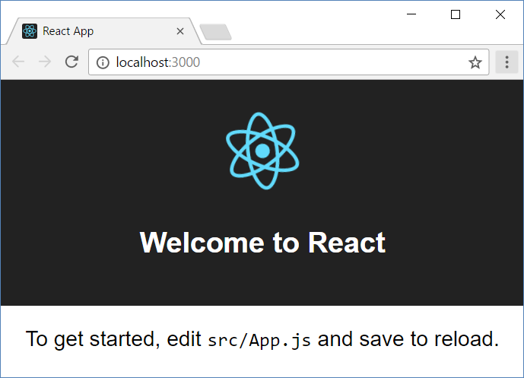
Install and Run the React App Creator
Run the React app creator
Starts your React app from the command line
Browse you app from http://localhost:3000
create-react-app react-example
npm start

Slide 13
Finding Information
Visit the official website
Documentation
Online sandbox
https://reactjs.org/
https://reactjs.org/docs/installation.html
https://codesandbox.io/

Slide 14
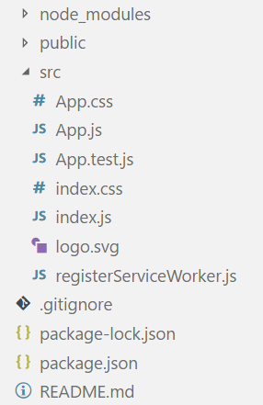
React App Structure
package.json – project configuration
Module name, dependencies, build actions
index.html
App main HTML file
index.js
App main JS file (startup script)
App.js, App.css, App.test.js
React component "App"

Slide 15


JSX
JSX Syntax
Overview, Syntax, Advantages

Slide 16

JSX Overview
JSX is React's JavaScript superset language
Has all of JavaScript's features and more
Unique approach to mixing HTML and JS
Compiles to plain JavaScript
<div className="red">Children Text</div>
JSX
React.createElement("div",
{ className: "red" },
"Children Text" [, …]);
component

Slide 17
JSX Syntax
<div className="red">Children Text</div>
Expression
<MyCounter count={3 + 5} />
let gameScores = {
player1: 2,
player2: 5
};
<DashboardUnit index="2" onClick={() => {}>
<h1>Scores</h1>
<Scoreboard className="results" scores={gameScores} />
</DashboardUnit>
Custom component
Pass variable as prop

Slide 18
JSX Rules and Principles
Standard elements use lowercase names
div, span, form, input, …
Custom components always use Pascal case
MyCustomComponent, Greeting, ScoreBoard, …
Component name cannot be an expression – use a variable instead
There must be a root element
More info at: https://reactjs.org/docs/jsx-in-depth.html

Slide 19
Compilation
JSX compiles to function calls
<div className="red">Children Text</div>
Element type (HTML tag name)
Properties object
React.createElement("div",
{ className: "red" },
"Children Text" [, …]);
List of children

Slide 20

Composition
Definition and Advantages

Slide 21
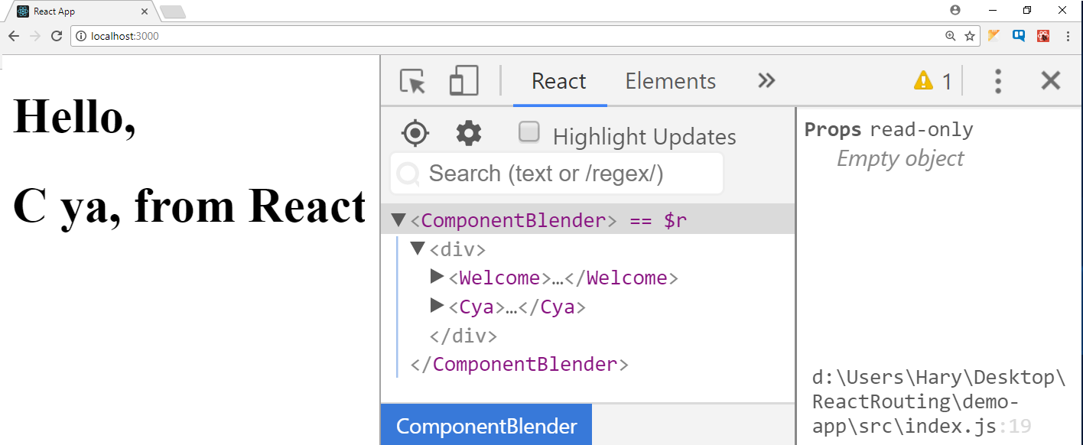
Composition
React components can be nested, like DOM elements
function Welcome() {
return <h1>Hello, from React</h1>;
}
function Cya() {
return <h1>C ya, from React</h1>;
}
function ComponentBlender() {
return (
<div>
<Welcome />
<Cya />
</div>
);
}
ReactDOM.render(<ComponentBlender />,
document.getElementById('root'));

Slide 22

Component Syntax
Names always start with uppercase
Tags must be closed
If there are no children – use self-closing tags
Information is passed via props
<Dropdown> A dropdown list
<UserHead name='homeHeader' />
<Menu>
<MenuItem>Do Something</MenuItem>
<MenuItem>Do Something Fun!</MenuItem>
<MenuItem>Do Something Else</MenuItem>
</Menu>
</Dropdown>;

Slide 23



Advantages
Encapsulate logic
Separate your code
Easier to maintain and debug
Allows reusability
Components are neat

Slide 24

Live Demo

Slide 25

Summary
…
…
…
React is a JavaScript library for building user interfaces
React uses all of the ES6 features
JSX is React's JavaScript superset language
Rendering an element is done in the following way:
<MyCounter count={3 + 5} />
ReactDOM.render(
<h1>Welcome to React.js!</h1>,
document.getElementById('root'));

Slide 26
https://softuni.bg/opencourses/reactjs-fundamentals

Slide 27













SoftUni Diamond Partners

Slide 28




SoftUni Organizational Partners

Slide 29




Trainings @ Software University (SoftUni)
Software University – High-Quality Education and Employment Opportunities
softuni.bg
Software University Foundation
http://softuni.foundation/
Software University @ Facebook
facebook.com/SoftwareUniversity
Software University Forums
forum.softuni.bg

Slide 30

License
This course (slides, examples, demos, videos, homework, etc.) is licensed under the "Creative Commons Attribution-NonCommercial-ShareAlike 4.0 International" license

